Slide 1



PRECCA
Prevention and Combating Corrupt Activities Act

Slide 2
The Prevention and Combating of Corrupt Activities Act (PRECCA)
aims to prevent and fight corruption in government and in the private sector

Slide 3
PURPOSE OF PRECCA
To strengthen measures to prevent and combat corruption
To provide for the offence of corruption and offences relating to corrupt activities
To provide for investigative measures in respect of corruption
To provide for the establishment of a register in order to restrict people or entities from contracting with the state
To place a duty on people in authority to report corruption
To provide for extraterritorial jurisdiction in respect of the offence of corruption

Slide 4
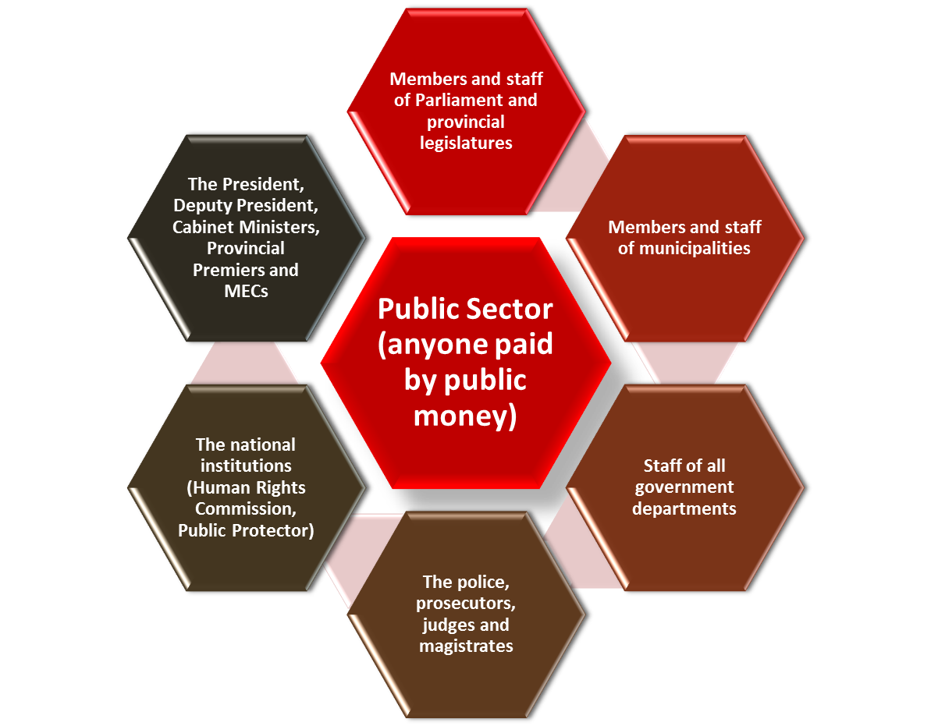
WE ARE ALL BOUND BY PRECCA
But in particular, it applies to:

Slide 5


Private sector (everyone working outside the public sector)
Individuals working for themselves or business companies
Companies or businesses
Civil society organisations (NGOs and community based organisations)

Slide 6
GENERAL OFFENCE OF CORRUPTION UNDER PRECCA
In simple terms, corruption is:
Someone offering to give or someone agreeing to receive
Gratification
Someone in a position of power using their power illegally or unfairly, where their conduct is unjustified.
Broadly, what does gratification mean?
Money
A donation
A vote
A service or a favour
Employment

Slide 7
SPECIFIC OFFENCES UNDER THE ACT
In addition to creating the general crime of corruption; the Act also criminalises specific corrupt activities.
Offences involving contracts
Offences involving a public official
Offences that involve judges, magistrates, and witnesses
Offences relating to sporting events
Offences of conflict of interest
Offences that involve tenders

Slide 8

OFFENCES INVOLVING CONTRACTS
It is a crime for anyone to accept money or favours to influence who gets a contract.
Example: A municipality needs to contract mechanics to service the state’s vehicles. A certain mechanic hears about this and he tells Ms X (who works for the municipality) that he will pay her R10 000 if she can convince the procurement officer to give them the contract.

Slide 9
OFFENCES INVOLVING A PUBLIC OFFICIAL
If anyone in the private sector offers a public official money or a favour to give them a benefit, they will be guilty of corruption.
If a public official offers to do something for someone in the private sector in exchange for money or a favour, the public official will be guilty of corruption.
Example: Bribing a traffic cop to escape a fine.

Slide 10
OFFENCES THAT INVOLVE JUDGES, MAGISTRATES AND WITNESSES
It is a crime to offer a magistrate or judge money or a favour to decide on a case in a certain way.
Example: A magistrate who accepts bribes to influence the outcome of a court case.

Slide 11
OFFENCES THAT INVOLVE TENDERS
The Act makes it a crime to offer or accept money or favours in order to influence the awarding of a tender.
Example: A member of a bid committee awards a contract to a particular bidder in exchange for a fee.

Slide 12
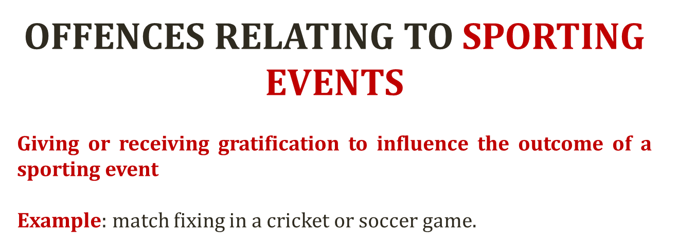


Slide 13
OFFENCES OF CONFLICT OF INTEREST
Any public officer who acquires a private interest in a contract connected with a public body is guilty of an offence.
Example: A mayor who awards a contract to her own catering company without disclosing the conflict of interest.
Exceptions to this offence:
Where the public officer’s conditions of employment do not prohibit him/her from holding such interest
Where the public official’s interest is as a shareholder of a listed company
Where the contract is awarded through a tender and the official’s contract of employment does not prohibit this and the tender process is independent.

Slide 14
PENALTIES UNDER THE ACT
The Act imposes penalties for people who are convicted of corrupt activities. Hefty prison sentences can be imposed, as well as fines.
If convicted in the High Court, one can receive up to life imprisonment.
If convicted in the regional magistrates’ court, one can receive a sentence of up to 18 years in prison.
If convicted in the district magistrates’ court, one can receive up to five years in prison.

Slide 15
REPORTING CORRUPTION UNDER PRECCA
Section 34 of the Act requires all people in positions of authority in both the public and private sector to report corruption to the police if it involves amounts worth more than R100 000.
Failure by people in positions of authority to report corruption is an offence!
People in positions of authority include:
The director-general/ head of national or provincial government
The municipal manager of the municipality
The principal or head of a tertiary institution
The director of a company
The executive manager of a bank
A partner in a partnership
CEOs

